Slide 1



Presentation of
Annika Bostedt, projectleader
Malin Wigg, temporary projectleader
Åke Nilsson, CFO & LL.M
Jacob Schulze,Communicator
SECISo 2.0
2018-10-01-2021-09-30

Slide 2
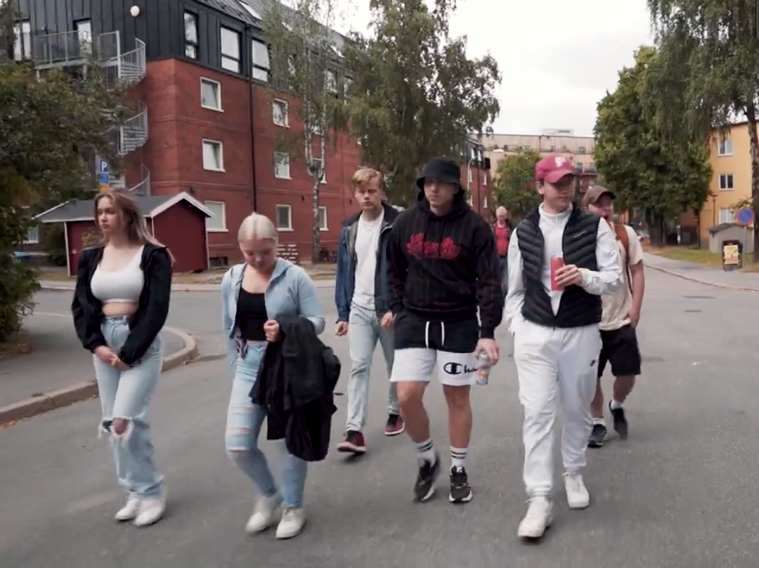

The national Association for social and mental health (RSMH)
Project owner

Slide 3

Background
Previous partnerships formed the basis of the project
Young people’s mental illness is increasing in Europe
The need to adapt supported education based on a Swedish context, to be able to implement the method

Slide 4

The purpose and target group of the project
Create conditions for implementing Supported Education in Sweden. The focus is a prevention against early school leavers.
Primarily target group: professionals who support in the prevention of young people who belong to NEET.

Slide 5
Partners
National partners | Transnational partners | Other partners
Mid Sweden University Uppsala municipality The association Urkraft The Actíva Foundation Helsingborg Municipality Boden Municipality Aprendere Sundsvall Municipality (Östersunds Municipality) | The Hanze University YA – Vocational College of Ostrobothnia GSM-group “Come in” Hamburg | Swedish Association of Local Authorities and Regions Nordic Welfere Centre The Nordic Association (Swedish Research Council for Health, Working Life and Welfare)

Slide 6
Activities
Study packages
Train the trainers
Civil society
SEd-network
Steering group meetings
Shadow work
Transnational meetings
Communication
Implementation course

Slide 7
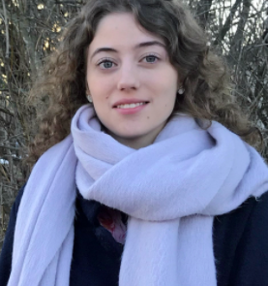
A former student
Linnea

Slide 8

Success factors
The generous funding Council of the European Social Fund in Sweden
The project has contributed to raising awareness of the method's opportunities to be both preventive and rehabilitative
An ongoing network building
Timing with a demand for a method that can prevent school dropouts
A continuous improvement work around implementation and problem solving of the method

Slide 9

Challenges
Financing matters
A simple method with a complex reality
Lack of cross-border cooperation
To get the method already in primary school

Slide 10
How do we proceed?
Peer support groups
SEd-network
Transnational exchanges
Financial matters

Slide 11
Do you have any questions? Please, contact us!
Thanks for listening!
Annika Bostedt, annika.bostedt@rsmh.se
Malin Wigg, malin.wigg@rsmh.se
Åke Nilsson, ake.nilsson@rsmh.se
Read more:
www.seciso.org
www.rsmh.se

